Slide 1


SOCIAL MEDIA ANALYSIS
Instagram User Engagement & Marketing Insights
BY:- Chandni Kalchuri
Date:- 28/03/2026
“SQL Project:- Meta”

Slide 2

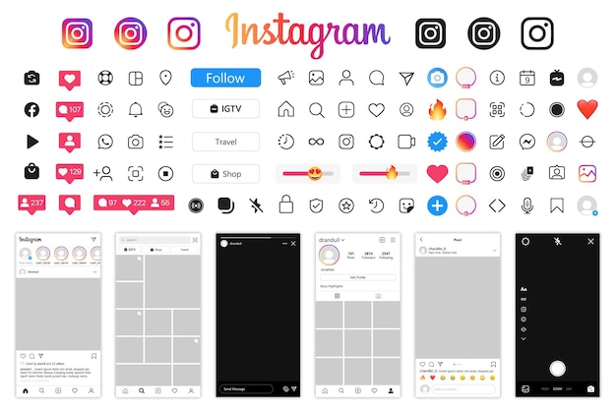
INTRODUCTION
Instagram generate large user interaction data.
Data helps understand user behavior.
Enables better marketing decision.
Improves engagement & growth.

Slide 3


PROBLEM STATEMENT & OBJECTIVES
Problem Statement:
Analyze user activity & engagement Patterns.
Objectives:
Increase user engagement.
Identify high-value users
Improve marketing strategies.

Slide 4
DATA OVERVIEW
[Users]
[Photos]
[Likes]
[Comments]
[Follows]
[Tags]
[Photo_Tags]
Dataset:
Users, Posts, Likes, Comments
Follows & Hashtags
Data Quality:
No NULL values
No duplicate records
Clean dataset

Slide 5
Database Schema
Tables:
• Users (id, username, created_at) • Photos (id, user_id, image_url) • Likes (user_id, photo_id) • Comments (id, user_id, photo_id) • Follows (follower_id, followee_id) • Tags (id, tag_name) • Photo_Tags (photo_id, tag_id)

Slide 6

Methodology
[SQL Techniques]
CTE (Common Table Expressions)
JOIN operations (INNER, LEFT JOIN)
GROUP BY for aggregation
Window Functions (RANKING)

Slide 7


[Data Processing]
Aggregation of likes, comments, posts
Calculation of engagement metrics
Handling NULL values using COALESCE
Removing duplicates using DISTINCT
[Analysis Approach]
User segmentation
Engagement calculation
Hashtag analysis
Influencer identification

Slide 8
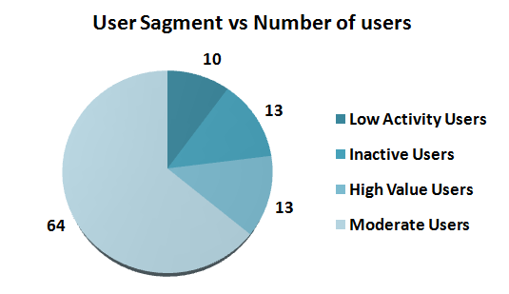
User Activity Distribution
Users segmented into activity levels
Majority are moderately active
Few users drive high engagement
Figure 1: Distribution of Users by Activity level

Slide 9
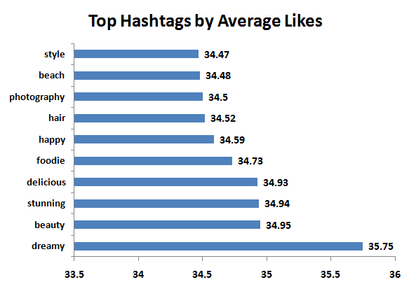
Top Hashtags by Average Likes
Identifies popular hashtags
Improves content reach
Helps in targeted campaigns
Figure 2: Top Hashtags Based on Average Engagement

Slide 10
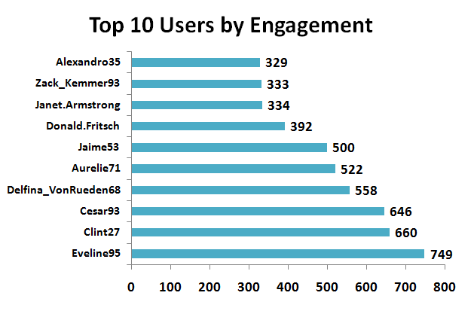
Top User by Engagement
Users ranked by Engagement
Few users dominate interaction
Potential influencers identified
Figure 3: Top Users Based on Engagement

Slide 11
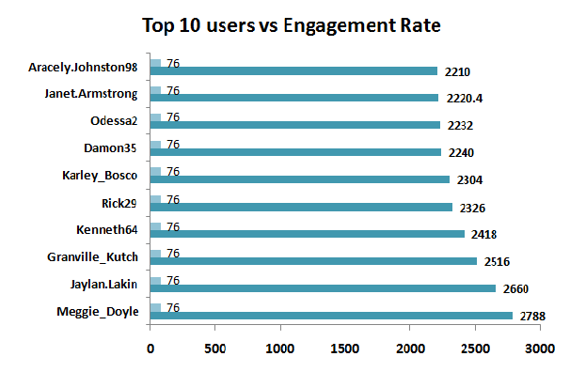
Influencer Identification
High followers + high engagement
Ideal for brand collaborations
Boost Marketing Performance
Figure 4: Top Influencers Based on Engagement Rate

Slide 12
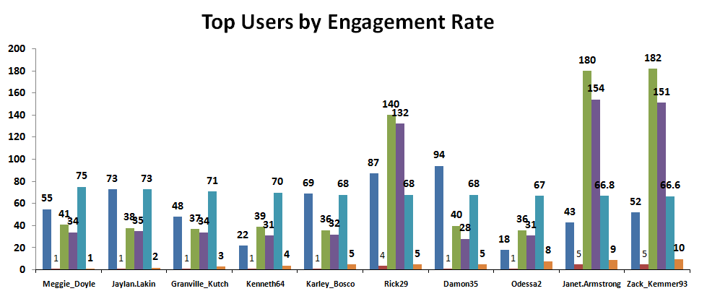
Engagement Rate Analysis
Engagement = (Likes + Comments) per post
Measures content performance
Higher = better user interaction
Figure 5: Engagement Rate Comparison

Slide 13
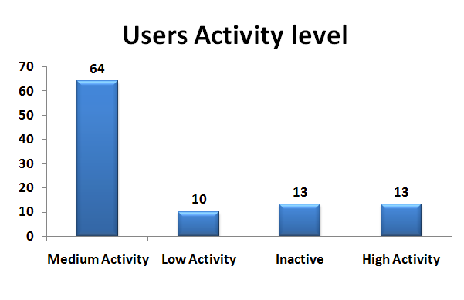
User Segmentation Analysis
Users divided into segments
High-value users drive engagement
Majority are moderately active
Figure 6: User Segmentation Based on Activity Levels

Slide 14



Target High Engagement User
Focus on high engagement users
Useful for marketing campaigns
Influences audience behavior
Figure 7: High Engagement Users For Targeted Marketing

Slide 15
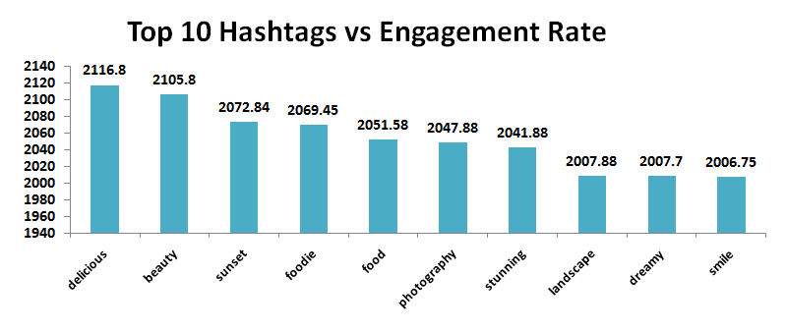
Hashtag Strategy Optimization
Use high-performing hashtags
Improve visibility
Increase engagement
Figure 8: High-Performing Hashtags For Content Strategy

Slide 16

Conclusion
• Majority users are moderately active • Few users drive high engagement • High engagement users are key for marketing • Hashtags improve visibility 💡 Final Impact: • Improves engagement & growth • Supports data-driven decisions

Slide 17

THANKYOU

